Slide 1
AIMS Redesign Subcommittee
June 5th, 2023
Full-Committee Meeting

Slide 2
Agenda
Reporting Enrollment Data
Pacing (AIMS Submissions)
ISC/FTE Table Inclusion Criteria
COVID-19 Supplement
AIMS/PDP Overlap?

Slide 3
Reporting Enrollment Data
There is a need to create a standard process and to have a single number for reporting enrollment
Differences between fall/spring enrollment numbers and annual report.
Live vs. Frozen Data/Census Days
Aspects to Consider:
Fall reports are intended to provide the most up-to-date enrollment numbers for various reporting purposes
Gender breakdown is only being collected in the fall
Reporting Enrollment Data
Pacing
ISC/FTE Table Inclusion Criteria
COVID-19 Supplement
AIMS/PDP Overlap?

Slide 4
Reporting Enrollment Data
There is a need to create a standard process and to have a single number for reporting enrollment
Differences between fall/spring enrollment numbers and annual report.
Live vs. Frozen Data/Census Days
Aspects to Consider:
Possible Census/Freezing Dates
IPEDS – October 15th
BIE - ???
2 weeks after classes start
3 weeks after classes start
Reporting Enrollment Data
Pacing
ISC/FTE Table Inclusion Criteria
COVID-19 Supplement
AIMS/PDP Overlap?

Slide 5
Reporting Enrollment Data
Pacing
ISC/FTE Table Inclusion Criteria
COVID-19 Supplement
AIMS/PDP Overlap?
Pacing
Proposed spring submission deadline: May 8th for schools on the quarter system
Is there a desire to distribute data reporting tasks throughout the year?
Aspects to consider:
Timeline in relation to academic calendar
What data is finalized when?
Workload at various times of the year.

Slide 6
Reporting Enrollment Data
Pacing
ISC/FTE Table Inclusion Criteria
COVID-19 Supplement
AIMS/PDP Overlap?
Spring Interim Survey
April 1st
Send out spring survey links
May 1st 8th
Spring survey data due to AIHEC
Fall Interim Survey
October 1st
Send out Fall survey links
November 1st
Fall survey data due to AIHEC
Annual Survey
October 1st
Send out annual report survey links
December 1st
Initial survey data due to AIHEC
January 15th
Final Annual Survey due to AIHEC
Data Collected on Annual Report
Enrollment Numbers
Tribal Affiliations
Student Demographics
Retention, Graduation, Persistence
Completer Information
Community Education Enrollment
Financial Aid
Academic Building Info
Research/Research Equipment
Course Enrollment
Distance Learning

Slide 7
ISC/FTE Calculations
Is there a desire/capacity to count…
non-federally recognized indigenous students?
Missing documentation or members of non-federally recognized tribes.
dual credit/dual enrolled students
students not meeting satisfactory academic performance
Include these students in other tables?
Students pursing non-degree/certificate credentials?
Awards, diplomas, endorsements, etc.
Aspects to Consider:
Desire to have ISC/FTE table mirror enrollment table and/or BIE Form 22
Are institutions equipped to make these distinctions?
Which metrics should include this differentiation?
Reporting Enrollment Data
Pacing
ISC/FTE Table Inclusion Criteria
COVID-19 Supplement
AIMS/PDP Overlap?

Slide 8
Reporting Enrollment Data
Pacing
ISC/FTE Table Inclusion Criteria
COVID-19 Supplement
AIMS/PDP Overlap?
Impacted Tabs
ISC/FTE
Tribal Affiliations
First time students
General student population
Program specific enrollment
Completions
Academic Core
Remedial Dev Courses
Distance Learning
Students with disabilities

Slide 9
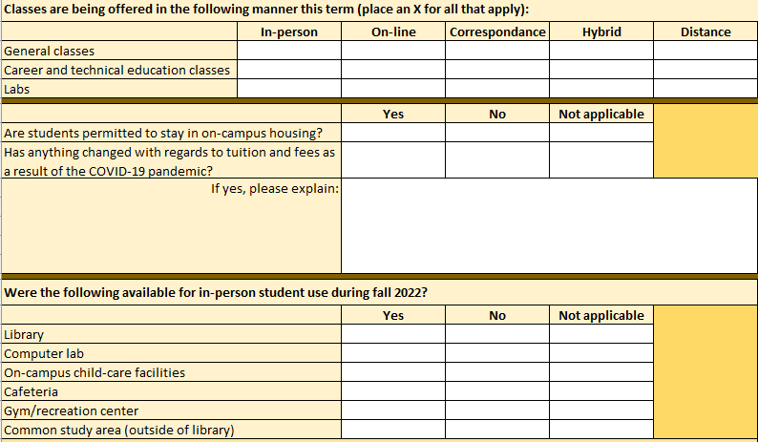
Reporting Enrollment Data
Pacing
ISC/FTE Table Inclusion Criteria
COVID-19 Supplement
AIMS/PDP Overlap?
COVID-19 Supplement
Is the COVID-19 Supplement Tab on the Fall Survey still relevant/useful for institutions?
If not, remove?

Slide 10
Reporting Enrollment Data
Pacing
ISC/FTE Table Inclusion Criteria
COVID-19 Supplement
AIMS/PDP Overlap?
AIMS/PDP Overlap?
Original Thought: Remove redundant variables in AIMS being collected by PDP
Current Status:
Students who identify as AI/AN AND any other race/ethnicity will be identified as “Two or More Races” in the PDP dashboards
Will be differentiated in raw data files
Considerations:
Institutions will not be able to differentiate a significant portion of AI/AN students in dashboards
Question: Do we want to keep overlapping AIMS variables to for easier comparisons between AI/AN and non-Native students?

Slide 11
Next Steps
Sharepoint Page with Subcommittee Materials
Codebook Working Group Meeting
Next Month’s Focus:
Leftover Discussion

